Slide 1
Examples of Mean, Median & Mode :- Agenda : 1.)Dot Plots 2.)Histograms 3.)Missing Value
Let’s Start Learning with practical examples :-

Slide 2
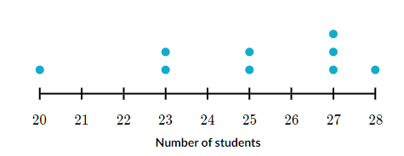
Dot Plots :-
A dot plot consists of a horizontal scale (a number line) on which dots are placed
to show the numerical values of the data. If a data value repeats the dots are piled up
at that location. One dot for each repetition. We say that the dot plot displays
the distribution of the data.
1.)Below are the data points which shows the data distribution of Numb of Students in a class . Find the median, mode of the Students
20,23,23,25,25,27,27,27,28 – Median – 9 – 5th Terms -25
X – fx
20 – 1
23-2
25-2

Slide 3
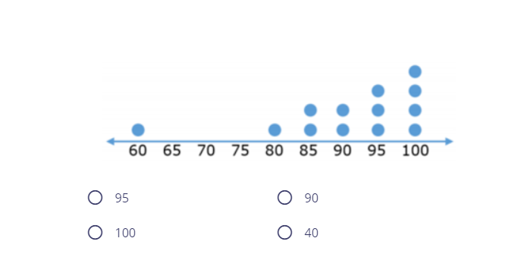
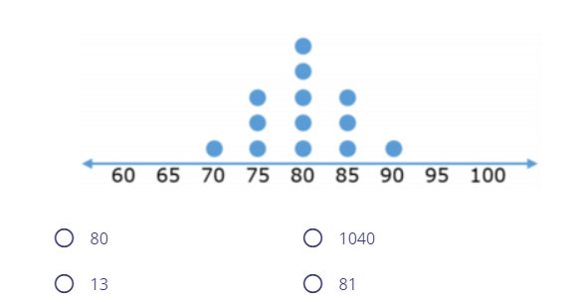
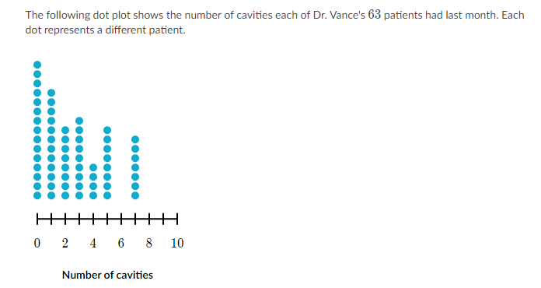
2.)Find the median of the dot Plot 3.)Mean of the Dot Plot (80)
60,80,85,85,90,90,95,95,95,100,100,100,100
4.)
Which of the following is a typical number of cavities one patient had?
i.)2
ii.)5
iii.)7
iv.)15

Slide 4
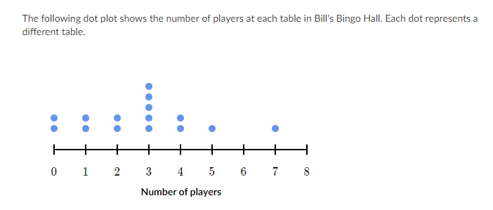

5.)What is the highest number of players at a table? Trying to convert the Dot Plot into
frequency table .
Table - Frequency(Num P)
T1 - 0
T2 -0
T3 – 1
T4-1
T5-2
T6-2
-- T10 - 7
6.)The table is a frequency table of the scores obtained in a competition. Find the median score.
Options: 2.5 , 3.5 , 4.5 , 2 - Answ : -

Slide 5
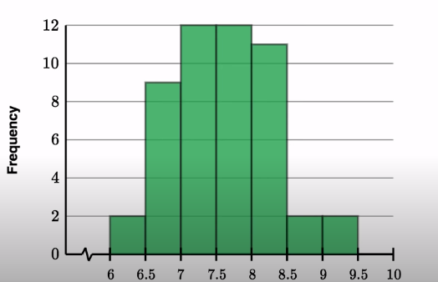
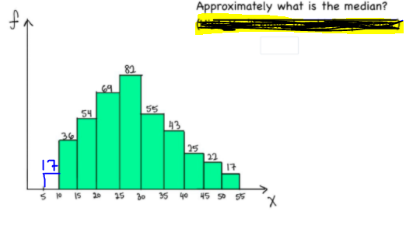
7.)The sample dataset is the sleep timings of consecutive days and made a histogram of the result. Which interval contains the median sleep amount ?
Answ - 7.5-8
x=
Total Obse = 2+9+12+12+11+2+2 = 50 (25th +26th/2
Amount of Sleep in hrs
8.)The sample dataset is the sleep timings of consecutive days and made a histogram of the result. Which interval contains the median sleep amount ?

Slide 6
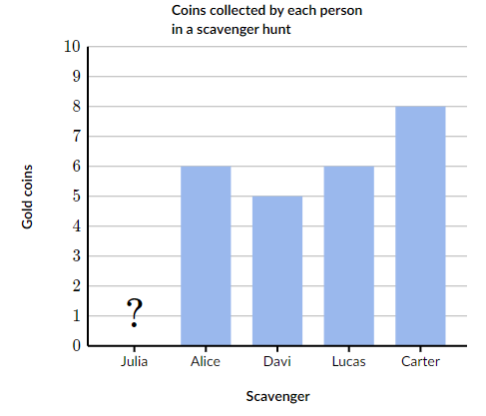
10.)Find the number of coins Julia found if the Mean=6
Mean = sum of obs/number of obsv
(x,6,5,6,8)
Mean =6
6=x+25/5
30 = x+25 = answ: 5
11.)Try to take a histogram which show ranges of numbers & find out mean.

